Slide 1

Category Code: Open Innovation
Problem Statement Title: Empowering Women Through a Centralized Digital Platform
Team Name: $ git commit -m "issues"
Institute Name: Vivekanand Education Society’s Institute of Technology

Slide 2

Idea / Approach details (& implemented features)
Community Support
Financial
Independence
Health Tracking
Safety & Legal Assistance
Discussion forums for health, legal rights, and career growth offer a safe space with anonymous participation, ensuring privacy and fostering a sisterhood no generic platform can match.
AI-driven job matching and freelance gig listings tailor opportunities to women’s skills and dreams, redefining economic empowerment with unmatched precision.
Menstrual health tracking, self-defense resources, and mental health tools—designed for all tech levels—create a holistic, woman-focused wellness hub no other site rivals.
Anonymous domestic violence reporting, emergency alerts, and encrypted communication deliver unmatched safety and justice, protecting women with cutting-edge security.

Slide 3
Innovation (Showstopper)
Astitva stands out due to its all-in-one approach, combining safety, employment, health, and community support in a single platform tailored for women. Key innovative features include:
AI-Powered Chatbot
SheFund Crowdfunding
Encrypted Privacy
Real-time Mapping
Provides instant, personalized responses to legal, health, and career queries, enhancing user support using RAG. Built with Gemini AI, uses NLP for 90% accurate responses to legal/health queries.
A dedicated mechanism to fund women’s emergencies and gender-equality projects, fostering community-driven solutions. Integrates a vetting process with NGO partners to ensure credibility and transparency, building trust among donors and recipients.
Secure communication ensure user safety and trust, critical for sensitive issues like domestic violence.
Features end-to-end encryption and IP masking, making it impossible to trace users even in high-risk situations.
Real-time mapping of essential resources, making help accessible even in urgent situations. OpenStreetMap integration pinpoints 200+ resources in 5 cities

Slide 4
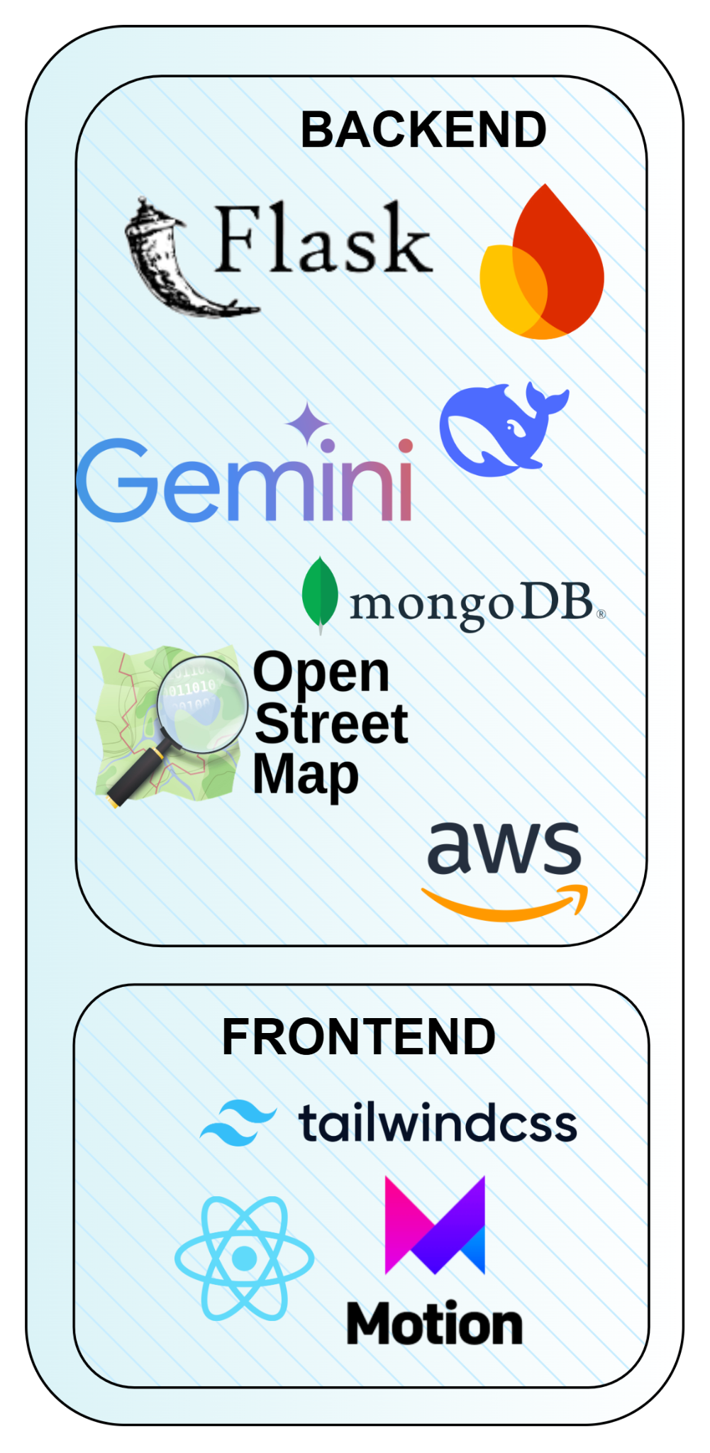
Tech Stack
🔹 Backend
Flask – Lightweight yet powerful, enabling rapid API development and seamless integration.
Gemini AI – Provides smart chatbot assistance for legal, health, and career-related queries.
MongoDB – NoSQL database ensuring flexible, scalable, and high-speed data storage.
OpenStreetMap – Enables real-time geolocation mapping for finding shelters, job centers, and medical facilities.
AWS – Cloud services for secure data storage, hosting, and high availability.
🔹 Frontend
React.js – Builds an interactive, dynamic, and scalable user experience.
Tailwind CSS – Provides a sleek, modern, and mobile-responsive UI.
Framer Motion – Adds smooth animations for an engaging and user-friendly interface.

Slide 5
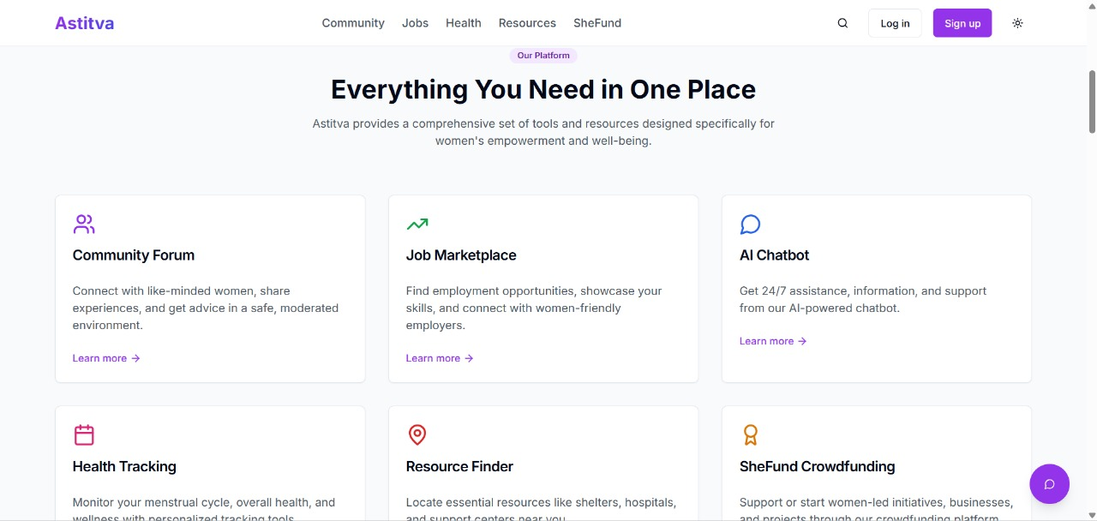
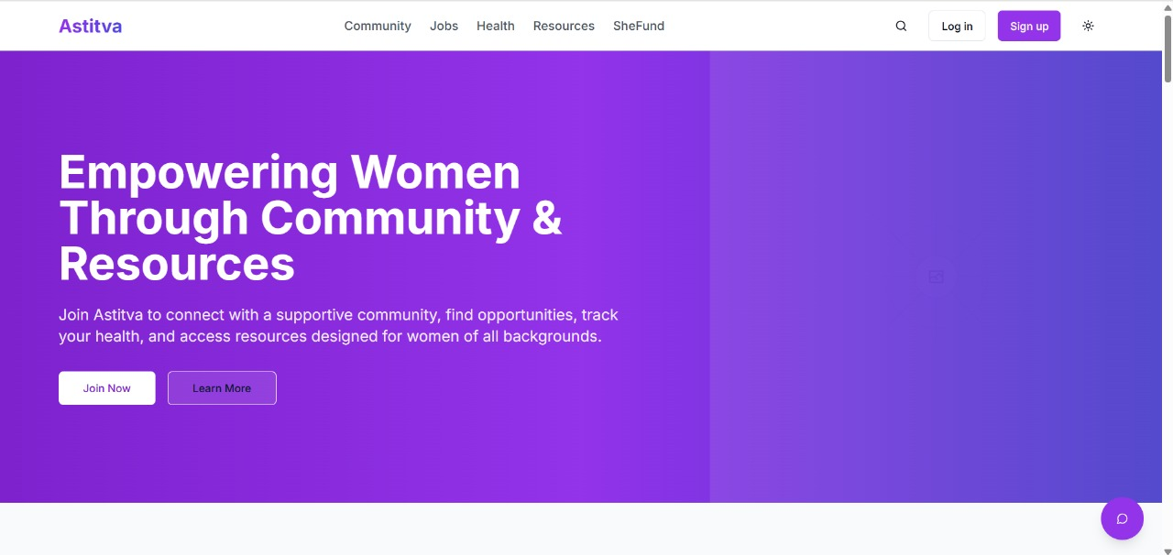
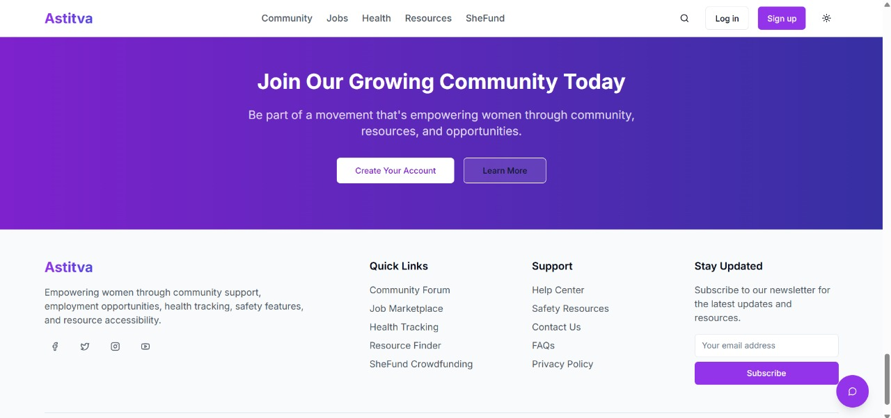
Implementation/Prototype/Use Case Diagram (screenshots)

Slide 6
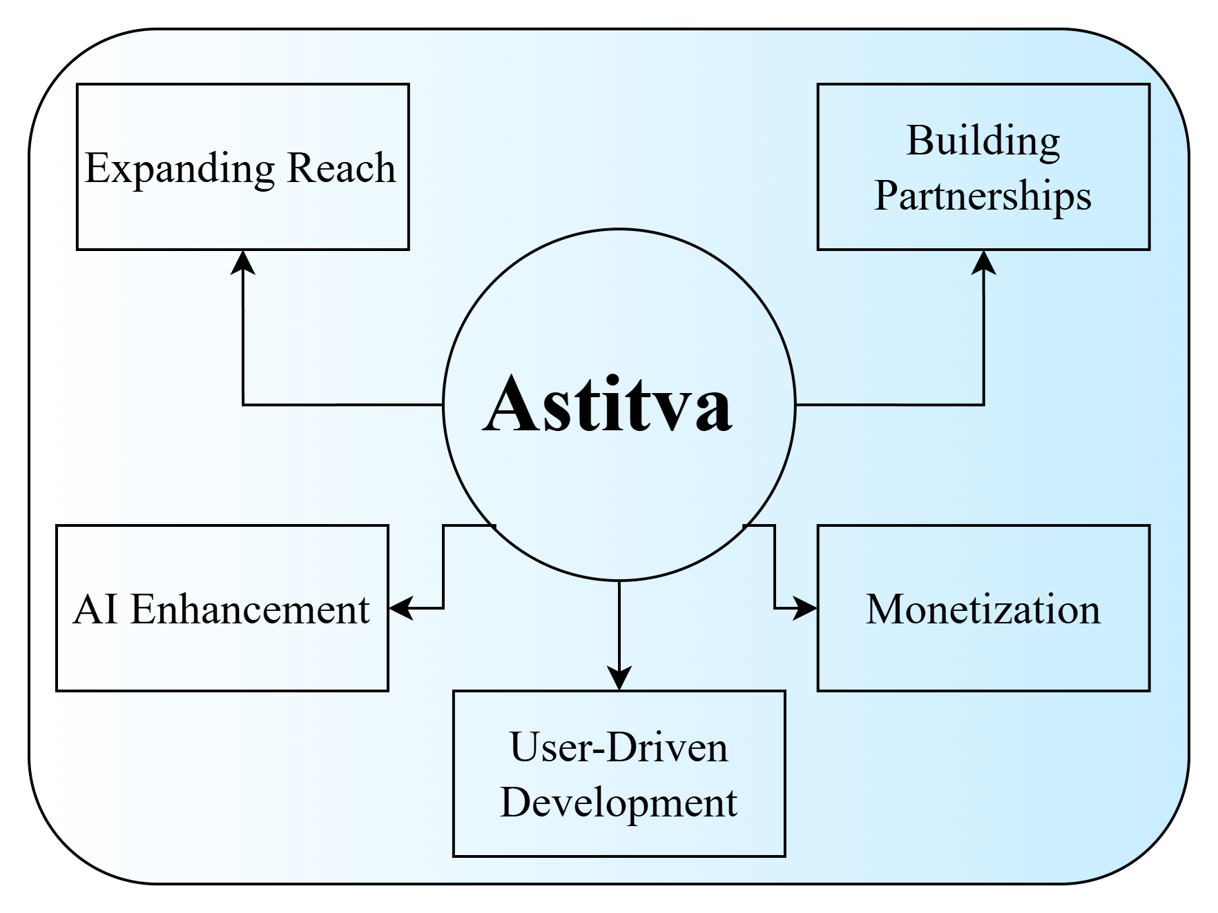
Future Objectives
1. AI & Innovation
Smarter AI support (Gemini)
Predictive safety/health alerts
2. Revenue Streams
Premium career services
NGO/government partnerships
3. Scaling Impact
Rural outreach via NGOs
Government integrations
For every woman who joins Astitva, we unlock a ripple effect—stronger families, economies, and communities.

